Slide 1

Fredonia, AZ Water Use Study:
Analyzing Current & Potential Water Sources
Team: Desert Rose H2O
Abdulrahman Alkandari
Aziz Malek
Stephen Taylor
Hanako Ueda

Slide 2
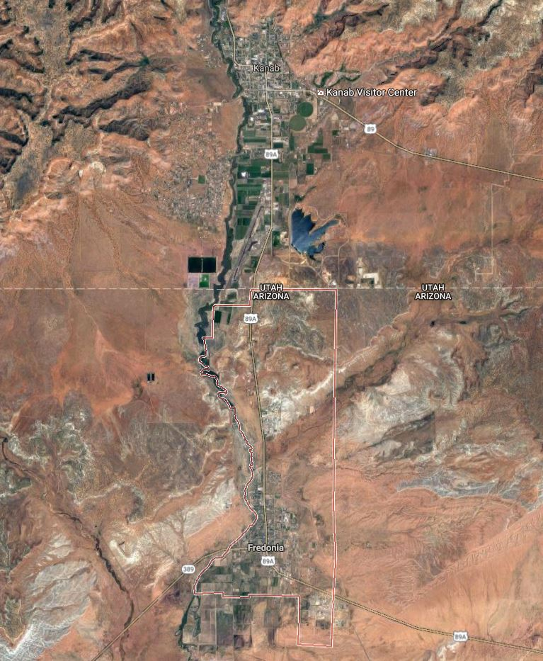
Background
Kanab, UT
Population: ~1300
Climate
  High Desert
  Annual Precipitation ~15”
Current Sources
  Public & Private Wells
  Kanab, UT
Wastewater Treatment
  Septic Tanks
  Public Works
Fredonia, AZ
[P1] Map of Fredonia/Kanab

Slide 3
Project Description
Characterize Current Water Sources and Usages
Estimate Future Demand
Investigate Additional Sources
Investigate Conservation Options

Slide 4
Scope
TASK 1: DATA REVIEW
  Current Water Usage & Well Information
  Aquifer Characteristics
TASK 2: INITIAL SITE VISIT
  Meet with Town Manager and Clerk
  Identify Modes of Public Outreach
  Photograph Water Infrastructure

Slide 5
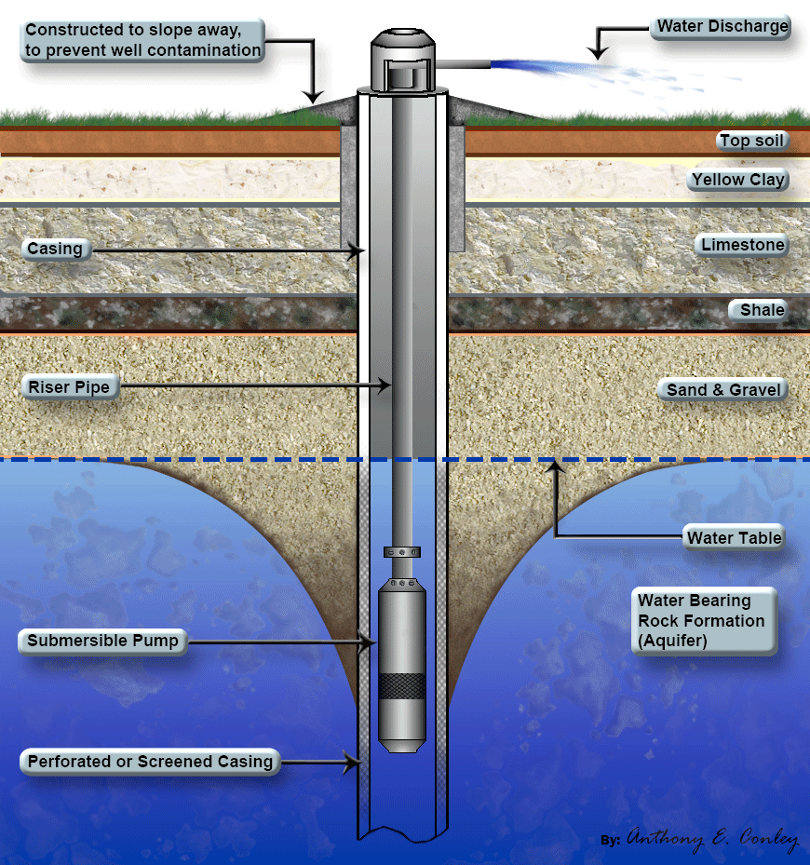
Scope (Continued)
TASK 3: SECOND SITE VISIT
  Diagnose City-Owned Wells
  Public Outreach
TASK 4: THIRD SITE VISIT
  Well Testing
[P2] Diagram of Typical Well
Stephen, 4

Slide 6
Scope (Continued)
TASK 5: IDENTIFICATION OF
ALTERNATIVE SOURCES
  Rainwater Harvesting
  New well Installation
  Wastewater Reuse
TASK 6: ANALYSIS
  Model Future Demand
  Prepare Summary of Current Sources
  Analyse Feasibility of Potential Sources
Hanako, 5

Slide 7
Staffing and Costs
Staff Title | Estimated Hours | Wages (Per Hour)* | Total Cost**
Engineer | 388 | $190.00 | $73,720.00
CAD Drafter | 40 | $80.00 | $3,200.00
Surveyor | 128 | $95.00 | $12,160.00
Water Quality Tech | 104 | X (fixed) | $220.00 (excluded)
Travel | 1200 miles | $0.35/mile | $420
Equipment | X | $225/day | $450
Total | 710 hours |  | $90,170.00
*Hourly wages include overhead costs and billing fees
**Assumes all staff is part of the Desert Rose H2O company

Slide 8
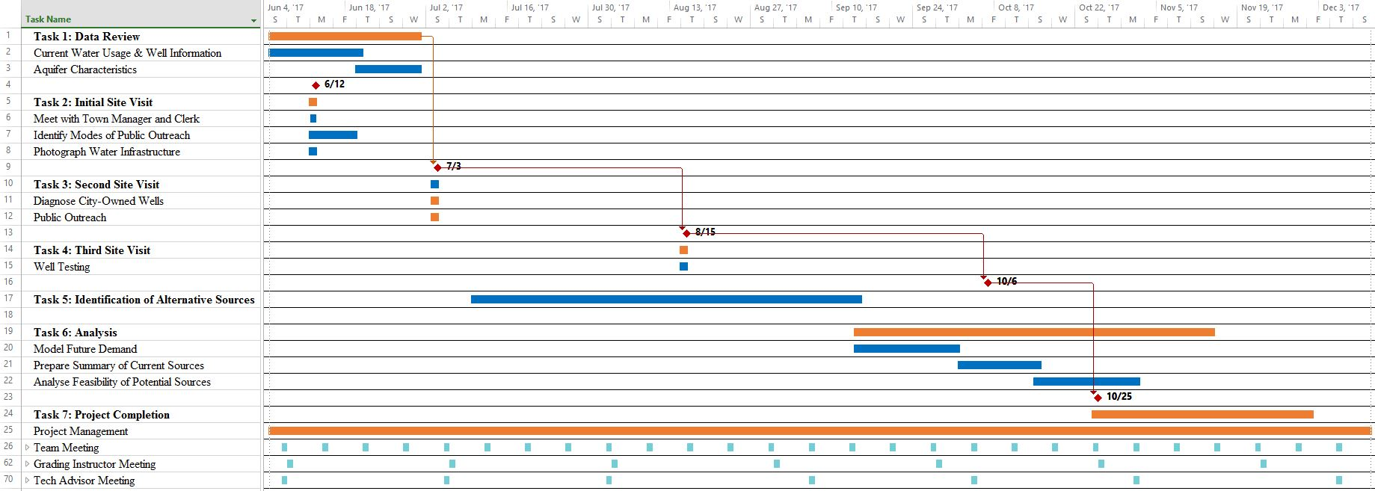
Schedule

Slide 9
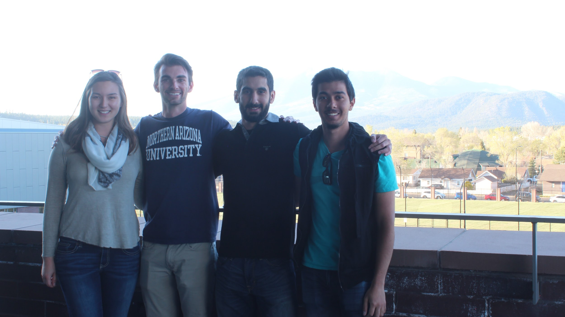
Questions ?
Stephen
Hanako
Abdul
Aziz

Slide 10
References
[1] “U.S. Drought Monitor”, University of Nebraska Lincoln, 2017. [Online]. Available: droughtmonitor.unl.edu/MapsAndData/Graph.aspx.
[2] N. S. Christensen et al, “The Effects of Climate Change on the Hydrology and Water Resources of the Colorado River Basin”, UW, Seattle, WA, Jan. 2004.
[3] "Web Soil Survey", US Department of Agriculture, 2016. [Online]. Available: http://websoilsurvey.sc.egov.usda.gov. [Accessed: 06- Feb- 2017].
[4] "Municipal and Industrial Water Supply Use in Kanab Creek and Virgin River Basin," in Utah Department of Natural Resources, 2006. [Online]. Available: digitallibrary.utah.gov. [Accessed: Jan. 27, 2017].
[5] D. Pool, K. Blasch, J. Callegary, S. Leake and L. Graser, "Regional Groundwater-Flow Model of the Redwall-Muav, Coconino, and Alluvial Basin Aquifer Systems of Northern and Central Arizona", Scientific Investigations Report 2010-5180, vol. 11, no. 1, pp. 25-28, 2017.
[6] "Water Harvesting Literature", Water Wise, 2011. [Online]. Available: http://cals.arizona.edu. [Accessed: 28- Jan- 2017].
[7] ACWF AZ wastewater treatment process. Available at: http://www.acwf.org/arizona/wastewater-services-fredonia [Accessed: 27 - Jan - 2017].
[8] Water quality testing: “Water Quality Method” Field Testing Methods. [Online]. Avaiable: www.who.int. [Accessed:27-Jan-2017].
[9] AZWater, Section 6.3 Kanab plateau basin Arizona Water Atlas, 6. Available at: www.azwater.gov. [Accessed: 26 - Jan - 2017].
[10]"Fredonia Arizona", City Data, 2017. [Online]. Available: http://www.city-data.com/. [Accessed: 20- Jan- 2017].

Slide 11
Photo References
References (Continued)
[11] “WaterCAD: Water Distribution Modeling and Analysis Software,” Water Distribution Analysis and Design Software - WaterCAD. [Online]. Available:www.bentley.com. [Accessed: 27-Jan-2017].
[12] GIS software: “Use of Geographic Information Systems (GIS) in water resources: A review,” SpringerLink. [Online]. Available: link.springer.com. [Accessed: 27-Jan-2017].
[13] “Method Detection Limit - Frequent Questions,” EPA, 16-Dec-2016. [Online]. Available: https://www.epa.gov/cwa-methods/method-detection-limit-frequent-questions. [Accessed: 17-Feb-2017].
[1] “Arizona Information, Photos and Maps,” Arizona Information, Photos and Maps. [Online]. Available: https://www.google.com/maps/place/Fredonia,+AZ+86022/@36.9882331,-112.5279623,16470m/data=!3m1!1e3!4m5!3m4!1s0x8734d18ac5975b33:0xfebe1f70864c6dc1!8m2!3d36.945542!4d-112.5265889. [Accessed: 22-Apr-2017].
[2] “Well Drilling,” Hernando County Florida Pump & Well Repair, 01-Jun-2014. [Online]. Available: http://brooksvillepumpandwellrepair.com/well-drilling/. [Accessed: 22-Apr-2017].
[3] K., “Engineering,” Rainwater Harvesting, 01-Jan-1970. [Online]. Available: http://engineering-dhameliya.blogspot.com/2012/05/rainwater-harvesting.html. [Accessed: 22-Apr-2017].
[4] “admin_666, “Wastewater reuse,” admin_666, 28-Jul-2013. [Online]. Available: http://www.yourhome.gov.au/water/wastewater-reuse. [Accessed: 22-Apr-2017].

